Slide 1
How to build Highly Available and Scalable Cloud solutions on Azure, what to do and what to avoid!
David Gristwood & Chris Marchal
Technical Evangelists

Slide 2



#msdevuk #azure
vipazure@microsoft.com
https://github.com/dxuk/
AzureWorkshops

Slide 3

Agenda
Main session:
What to do (Cloud Design Patterns and good practices)
What to avoid (Classic errors and mistakes)
Lunch
Afternoon
Interactive Chalk ’n’ Talk Group Discussion
Book 1:1 “office hours”
See Claire @ coffee break
David Gristwood David.Gristwood@microsoft.com
Chris Marchal Chris.Marchal@microsoft.com

Slide 4

https://pollev.com/ukdx
Who are you?
Notes:
https://www.polleverywhere.com/multiple_choice_polls/tB2ywb8sXljcKpp

Slide 5
The Question:
How do partners build very highly scalable and highly available cloud solutions that can perform with confidence on the Azure cloud, even under extreme loads?

Slide 6
2 subjects, 5 key areas
{“Scalability and Performance”}
David Gristwood
{“Resilience, Availability
and Disaster Recovery”}
Chris Marchal

Slide 7
{Scalability and Performance}
Good philosophy and strategies
Azure services you can lean on
Use the best tools at your disposal
Some well tested patterns
Notes:
How do I know that my service will perform to an acceptable level under a given load of users and can scale past that level when required?

Slide 8
General philosophy and strategies

Slide 9
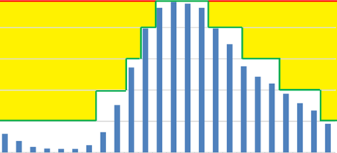
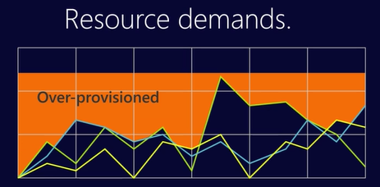
Scale out, not up
Scale out is a “good place” to be
Jump from 1 to n can be major step change
No real upper limits
No reliance on bespoke high performance hardware
finer granularity = cheaper
Use services to help scale workload
Use ones that spin up super-quickly, such as Azure App Services, Web jobs and Functions
Manage state carefully
Stateless services are easier to scale out
Externalise state to a distributed cache (Redis) where necessary
Good to think in terms of “Scale Units”
X amount of work can be done with a unit eg cars/hours on road
S1 IoT Hub handles 400,000 msg/day
Media Services streaming unit handles 200 Mbps

Slide 10
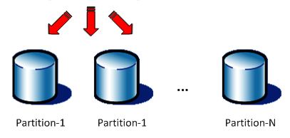
Partition your workload
Use decoupled architectural patterns
Queue Based Load Levelling, Competing Consumers, etc
Shard / Partition data layer
e.g. Table Storage with ‘sensible’ partition key
Consider data store capable of consistency vs availability trade-off
CAP theorem (aka Brewer's) states that it is impossible for a distributed system to simultaneously provide more than two out of three of the following guarantees
Consistency / Availability / Partition tolerance

Slide 11
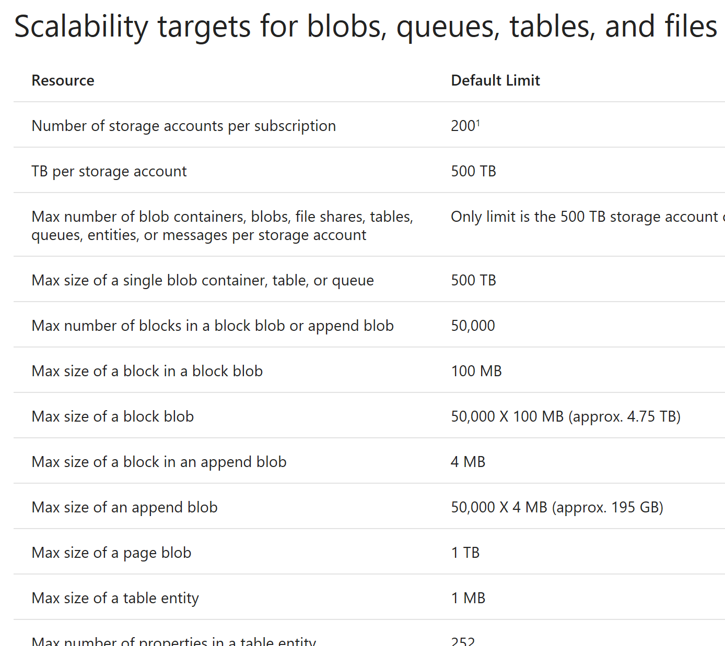
Understand Azure Storage Scalability & Performance Targets
Built in services have DDOS management protection
If requests are above a certain threshold, then throttling automatically kicks in
Max Per-IaaS VHD IOPS (Basic VM:200, Standard VM:500)
Max Per-Storage Account IOPS (20,000)
Managed Disks remove old limits
Such as: only 40 Standard VHDS per storage account can be maxed out on I/O before throttling occurs – don’t share storage accounts between lots of VMs.
Choose Standard or Premium Storage
Also understand Azure service limits, quotas, and constraints
https://docs.microsoft.com/en-us/azure/azure-subscription-service-limits
https://azure.microsoft.com/en-us/documentation/articles/storage-scalability-targets/

Slide 12
https://pollev.com/ukdx
How do you deal with High I/O Workloads ?
Notes:
https://www.polleverywhere.com/multiple_choice_polls/tB2ywb8sXljcKpp

Slide 13
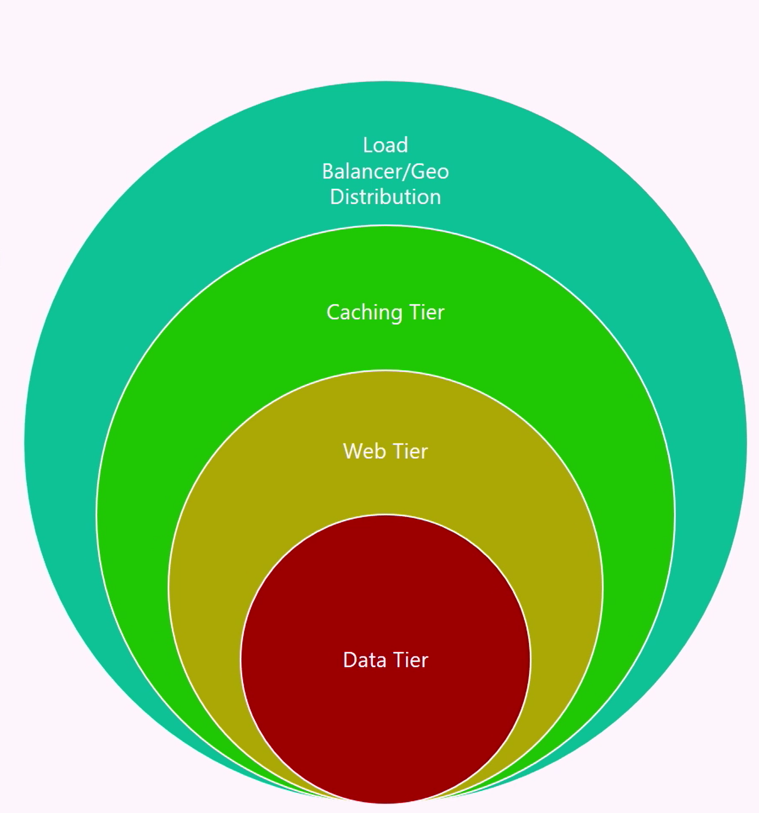
Use layered tiers
Each layer reduces call volume by an order of magnitude
Typical model
Geo-distribution of system
CDN to place assets at network edge
Cache to reduce impact on web pipeline
Sochi Olympics & Azure Media Services

Slide 14
Infrastructure

Slide 15
Managed Disks
Managing storage accounts associated with VM disks
Simpler and more scalable VM deployment
no storage account limits (20,000 IOPS / account)
2 performance tiers: Premium (SSD-based) & Standard (HDD-based)
Better reliability for Availability Sets
Azure Role-Based Access Control (RBAC)
Notes:
https://azure.microsoft.com/en-us/blog/announcing-general-availability-of-managed-disks-and-larger-scale-sets/
https://docs.microsoft.com/en-us/azure/storage/storage-managed-disks-overview

Slide 16
VM sizes
General Purpose
Balanced CPU/memory: dev & test workloads, low / med traffic sites, small / med db
A0-4 Basic, Av2 Std D1-5v2, D1-4v1, A0-7std
Compute Optimised
High CPU/memory ratio : medium web, network, app servers
F Series (SSD)
Memory optimised
High memory/core ratio: sql, cache, in-memory analytics
D11-15, G series
Storage optimised
High disk throughput: big data, sql, no-sql
L Series
GPU
Compute & graphics-intensive workloads
N Series
High Performance Compute
Fastest most powerful CPUs, RDMA
H Series, A8 - 11

Slide 17
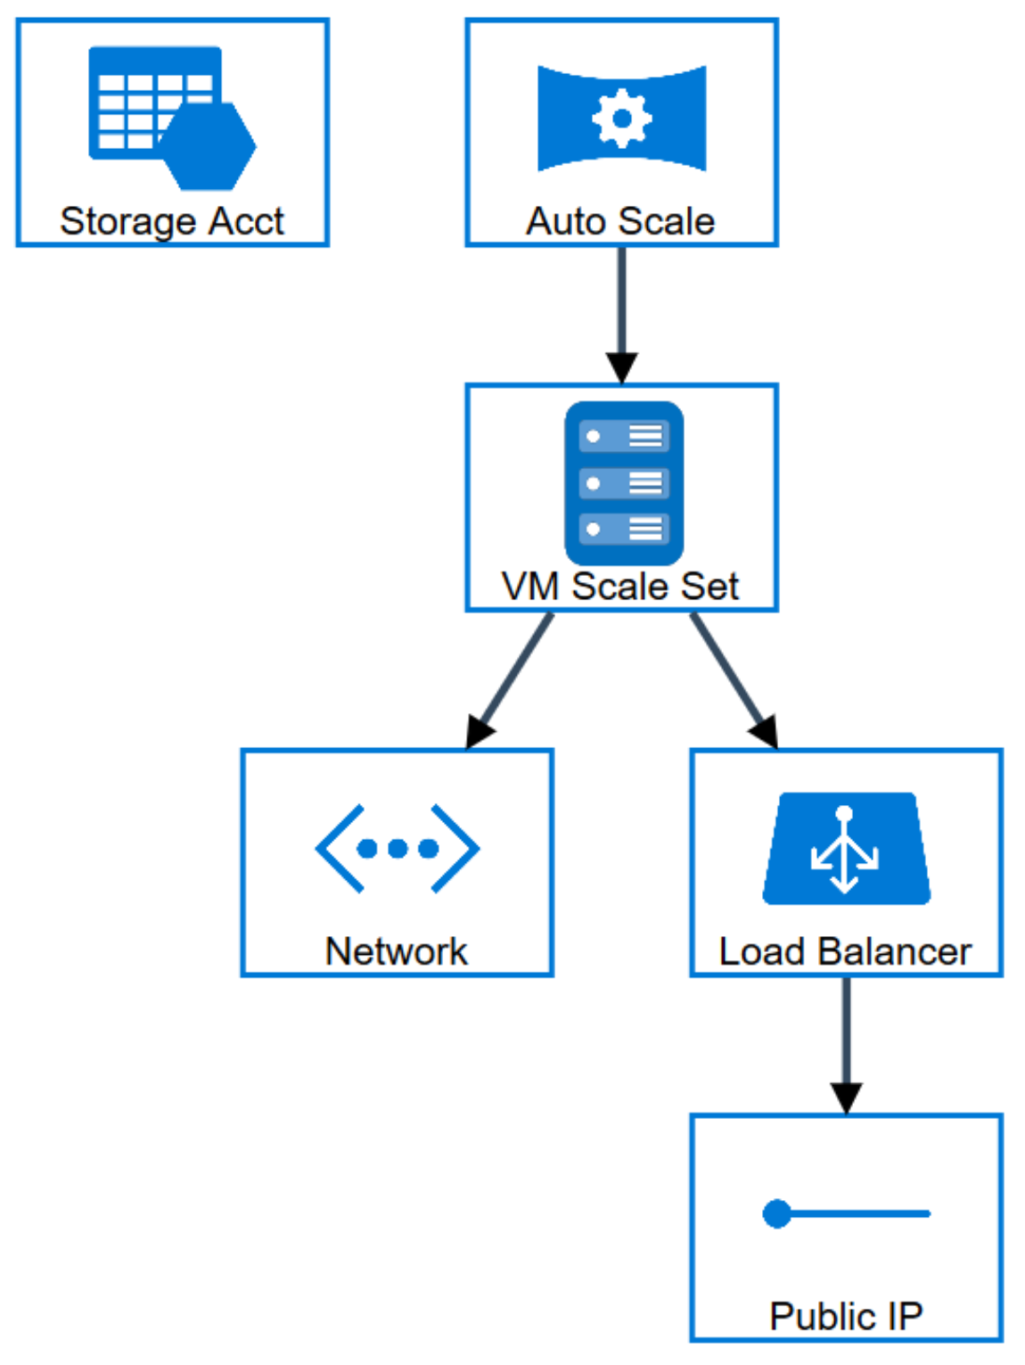
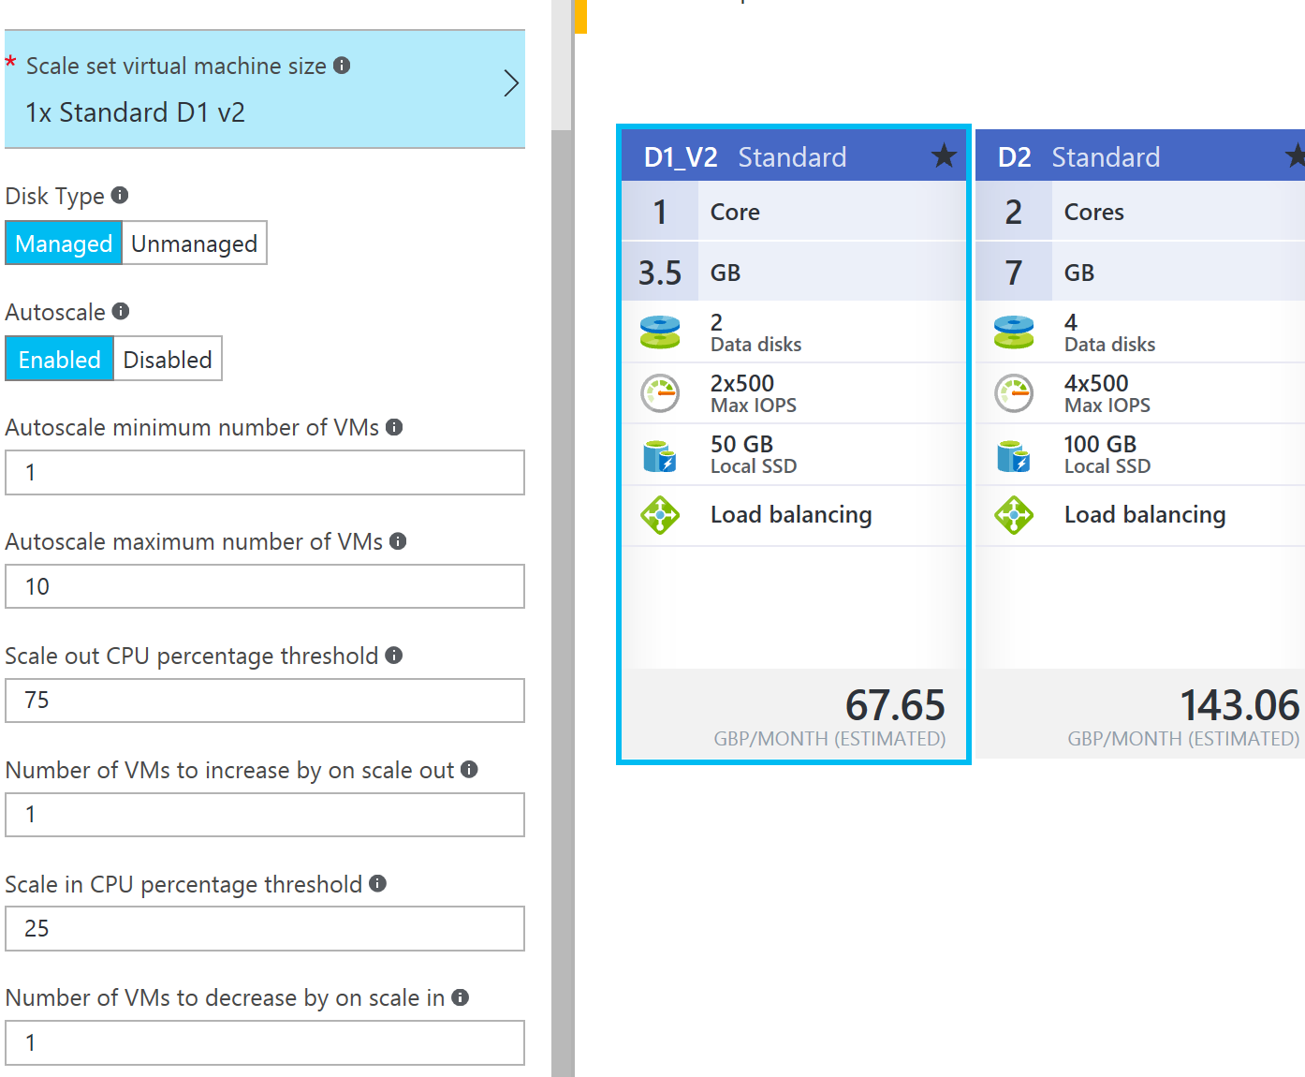
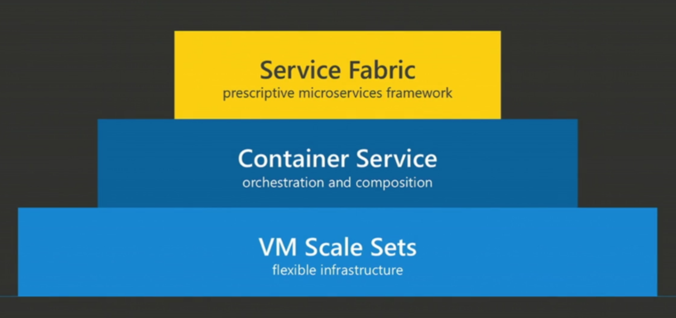
VM Scale Sets
Control it like IaaS, scale it like PaaS
Deploy and manage a set of identical VMs
Simplify networking
Supports Managed Disks
Auto scale support
Used by other Azure Services
Batch, Service Fabric, etc.

Slide 18
Azure Services

Slide 19

Polyglot Persistence
“human data”
“machine data”
Different databases are designed to solve different problems. Using a single database engine for all of the requirements usually leads to non-optimal solutions
e.g.:
User session
Catalogue data
Product search
Shopping cart
Orders database
Analytics
Reporting, ….
Transactional integrity, operational information, etc.
Independent, telemetry, insights, etc.
Azure Storage
Relational
NoSQL
Big Data
HDInsight

Slide 20
Use an appropriate type of Store
Storage Mechanism | Interaction | Starts at* | Min GB | Max TB | Use Case
‘Cool’ Block Blob storage | REST (Blob), SDKs | £0.01/GB | 0 | 500 | Archive, nearline unstructured https storage
‘Hot’ Block Blob storage | REST (Blob), SDKs | £0.02/GB | 0 | 500 | Online unstructured https storage
Virtual Machine Disk / Page Blob Storage | VM Only | £0.05/GB | 0 | 500 (Not per VM) | High Performance storage, up to 500 IOPS per disk volume (up to max volumes per VM type).
Table Storage | REST (Blob), SDKs | £0.07/GB | 0 | 500 | Tabular, non-relational (NoSQL) Mass-scale dictionary https lookup service, partitioned by default, no secondary indexes allowed.
Premium Virtual Machine Disk/ Page Blob Storage | VM Only | £0.13/GB | 128 | 35 | GUARANTEED High Performance storage, up to 5000 IOPS per disk volume (up to max volumes per VM type > 80,000 IOPS & 2TB / Second).
SQL Database Basic | T-SQL (TDS) | £2.33/GB * | 2 | 1 | Tabular, Scalable, Classic Relational DBMS, Always On
SQL Data Warehouse | T-SQL (TDS) | £1.03/GB * | 1024 | ~250 Compressed (~1PB) | Scalable, Tabular, Parallelized, Relational DBMS, can be paused.
DocumentDB | REST (Blob), SDKs | £4.62/GB * | 1 | 0.01 (10GB) | JSON Indexed document storage, can be partitioned.
Data Lake Store | WebHDFS | £0.06/GB * | 1024 | 1PB per file (!) | Hadoop based unstructured data storage layer. – Preview price includes 50% discount off US pricing, not available in Europe yet.
* These are indicative numbers, these numbers are variable on a number of factors. For example SQL DW starts billing at 1TB of capacity, storage has an access charge per million transactions.

Slide 21
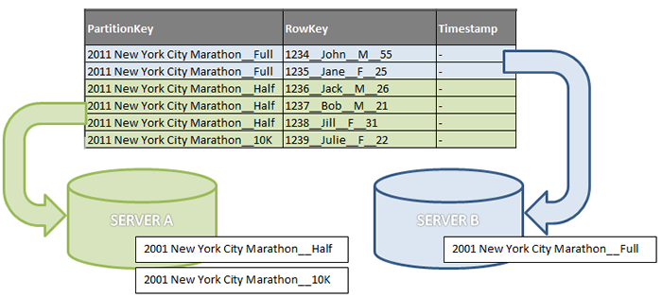
Designing a Scalable Partitioning Strategy for Azure Table Storage
Table storage is fast and low cost NoSQL store
1 MB max size of entity with a max 255 properties
Consider separate storage accounts to overcome any service limits
500 TB per account, 20,000 transactions per second per account
200 accounts per subscription
PartitionKey and RowKey combine to create single clustered index
Think about retrieval scenarios
Partitions are always served from one server
Avoid scans that go across multiple partitions
https://msdn.microsoft.com/en-us/library/azure/hh508997.aspx

Slide 22

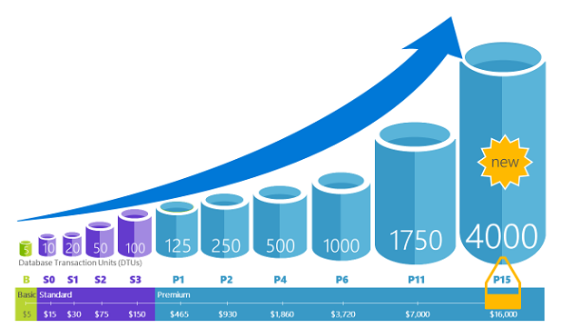
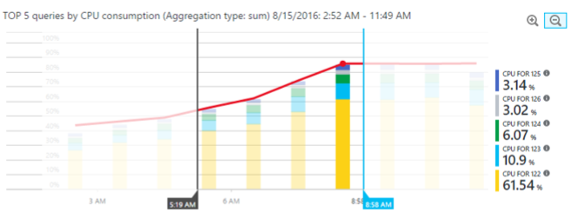
SQL Database
Scale performance on the fly
Within tier
Scale up for peak workloads, such as imports, heavy database access, etc
Advisor
recommendations on indexes, schema issues,…
Query Performance Insight
Deeper insight into DTU usage and top queries
Basic: 2 GB max size, 30 sessions
Standard: 250 GB max size, 200 sessions
Premium: 1 TB max size, 400 sessions
Notes:
https://docs.microsoft.com/en-us/azure/sql-database/sql-database-scale-up

Slide 23

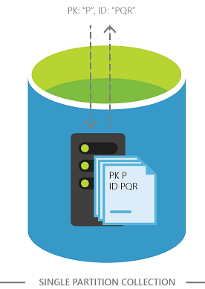
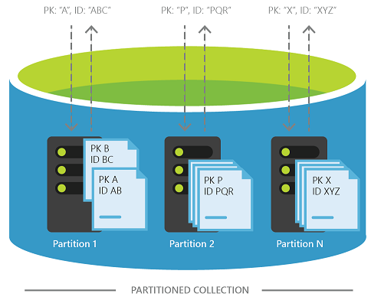
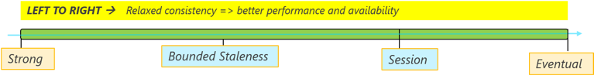
DocumentDB
“JSON based NoSQL store as a service”
Query using SQL & LINQ & MongoDB API
JavaScript for stored procedures, triggers
Guaranteed low latency
< 10 ms on reads, < 15 ms on writes
By default, indexes on all fields
Seamless partitioning
Choice of four consistency models
Strong, bounded staleness, session, & Eventual

Slide 24
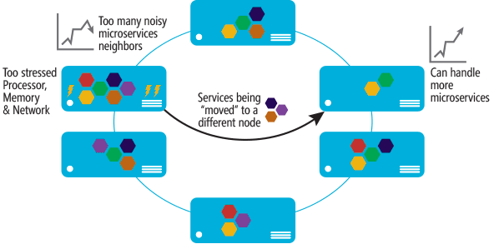
Microservice architectures scale well
Loosely coupled systems more flexible
Easier to detect and tune bottlenecks
Scale specific components

Slide 25
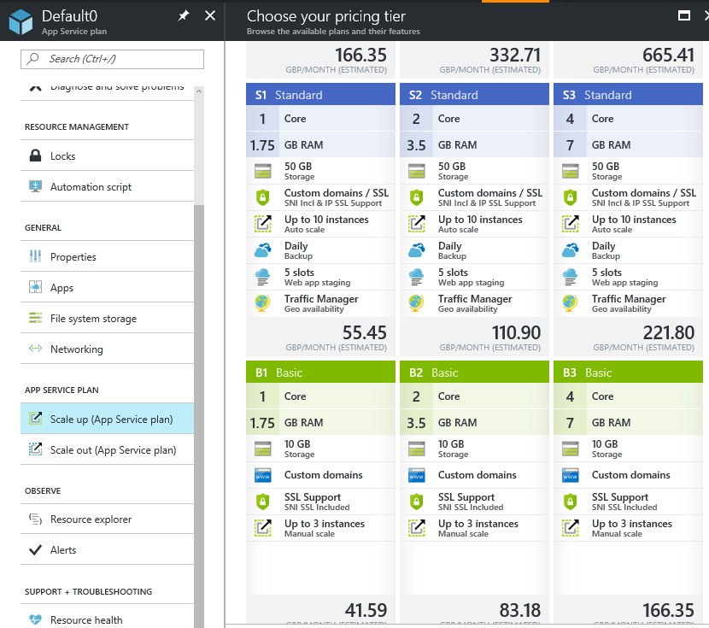
Azure App Services
Run web apps and web API
Supports global scale with high availability
DevOps optimization
CI & CD, A/B testing, deployment slots, etc
Service plans represent physical resources used to host your apps
Scale count (one, two, three instances, etc.)
Instance size (Small, Medium, Large)
SKU (Free, Shared, Basic, Standard*, Premium*)
* support autoscale

Slide 26
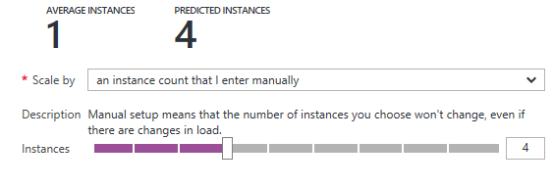
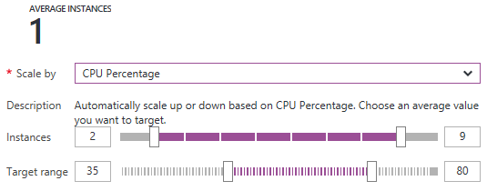
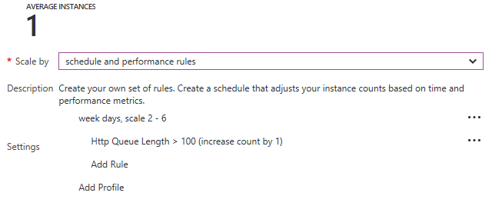
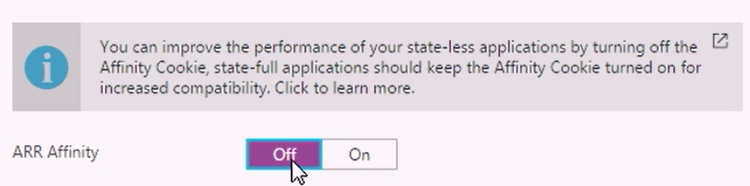
App Services Specific optimisations
Enable Auto-Scaling in App Service plan
Manually, CPU, schedule + rules
Prefer time based scale over auto-scale where possible
Tips
Enable AlwaysOn
Disable Session Affinity Cookie
//azure.microsoft.com/en-us/blog/disabling-arrs-instance-affinity-in-windows-azure-web-sites/
Notes:
https://docs.microsoft.com/en-gb/azure/monitoring-and-diagnostics/insights-how-to-scale?toc=%2fazure%2fapp-service-web%2ftoc.json
If you don’t need web affinity, turn it off, this will mean being routed to a node more quickly, and a more even load balancing across your services.
If your site traffic is sporadic, you would probably want to keep the site spun-up and in memory : for an instantaneous response discuss Always On
Auto-Scaling is a given
Scale up: Get more CPU, memory, disk space, and extra features like dedicated virtual machines (VMs), custom domains and certificates, staging slots, autoscaling, and more. You scale up by changing the pricing tier of the App Service plan that your app belongs to.
Scale out: Increase the number of VM instances that run your app. You can scale out to as many as 20 instances, depending on your pricing tier
The scale settings take only seconds to apply and affect all apps in your App Service plan. They do not require you to change your code or redeploy your application.

Slide 27

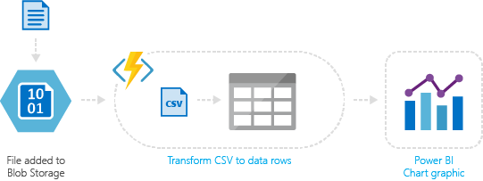
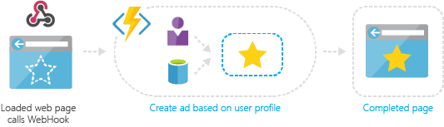
Azure Functions
Serverless computing
With serverless consumption plan
Built on App Service WebJobs
Build “nano-services” as individual functions
Event driven model
Timer, http hook, queues, storage, etc
Easy way to implement load levelling
No upper limit on compute
Easy to test, tune and deploy

Slide 28
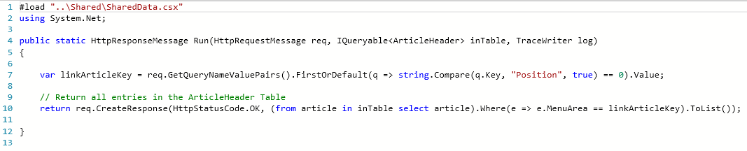
Functions programming concepts (C#)
Trigger
Input(s)
Output
Code

Slide 29
Tools

Slide 30
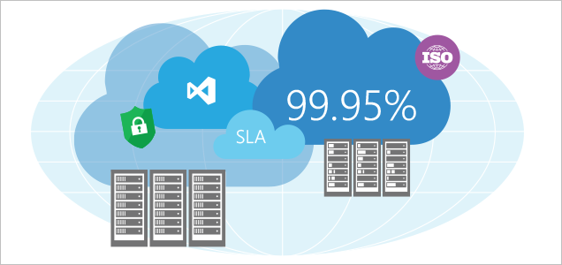
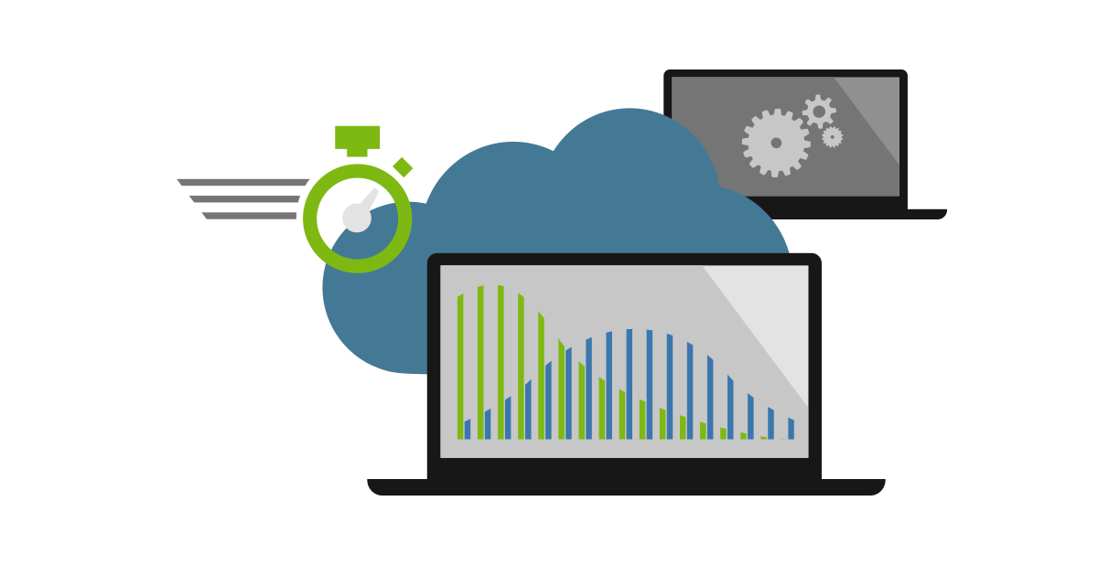
Load test your application before deployment
At the absolute least, ensure that some kind of automated load testing is performed to detect a noticeable change in performance of specific, critical endpoints
Ideally set actual goals
Expected req/sec, latency needed, concurrency
Explore real vs perceived latency
Test the application at significant load to ensure that spikes in user activity and load will not take down the application at burst times.
Test your application automatically before deployment using CI / CD Practices
The earlier you find these problems, cheaper they are to fix
Notes:
Show of hands for the audience…. All hands in the air.

Slide 31
https://pollev.com/ukdx
How often do you load test your application?
Notes:
https://www.polleverywhere.com/multiple_choice_polls/tB2ywb8sXljcKpp

Slide 32
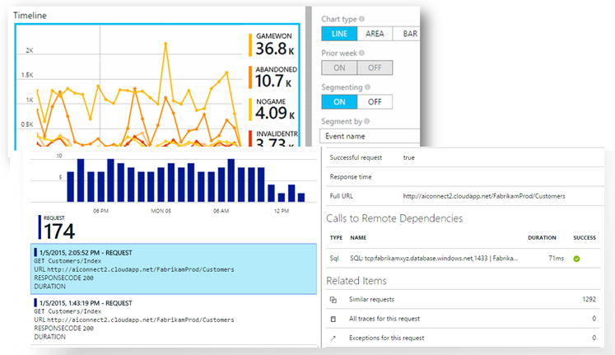
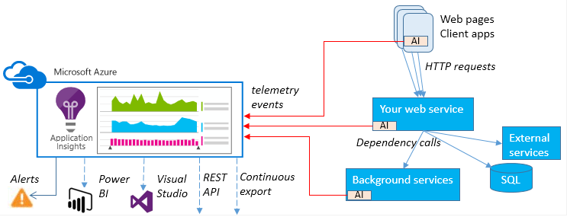
Azure Application Insights
Powerful analytics tool
Instrumentation package in your application monitors your app and sends telemetry data to the portal
Impact on app's performance is very small
Diagnostic search for instance data
Metrics Explorer for aggregated data
Dashboards
Live Metrics Stream
Analytics with query language
Automatic and manual alerts
Power BI integration

Slide 33
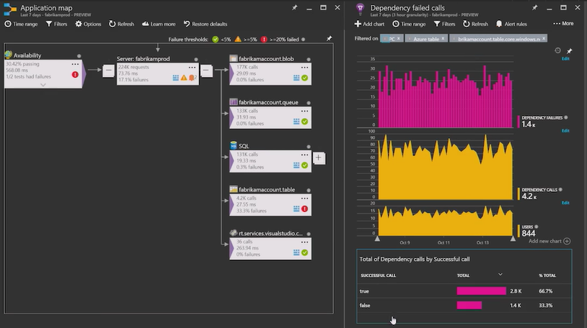
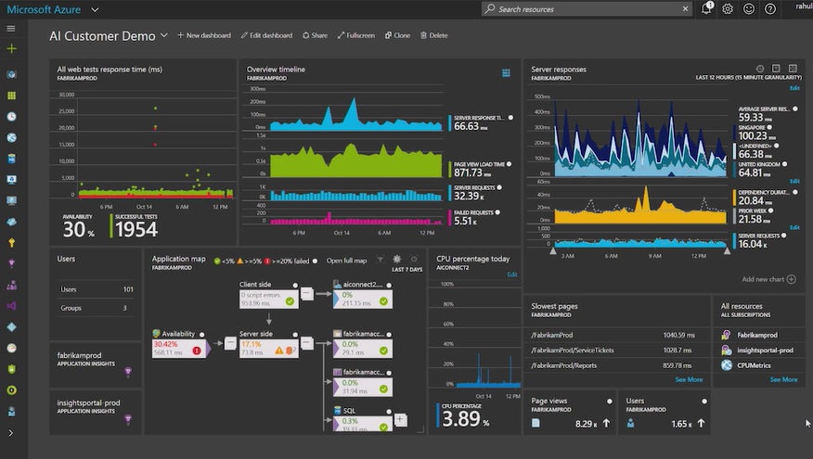
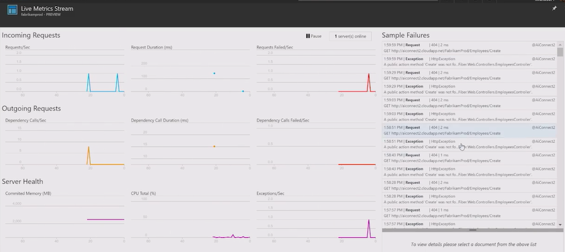
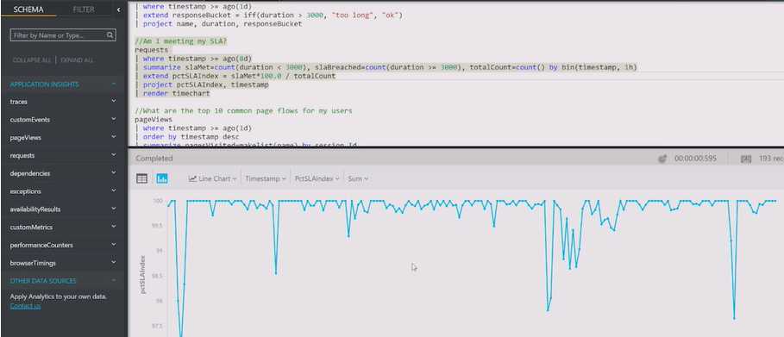
Application Map
Live Stream
Analytics Query

Slide 34
Patterns

Slide 35
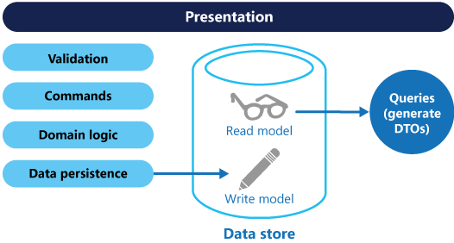
Command and Query Responsibility Separation (CQRS) Pattern
“Separate reads from writes”
Trade off of complexity for performance
Avoid multi-master issues in geo-distributed systems
https://aka.ms/CQRS-Pattern
Notes:
CQRS – Initially have read and write through the same channel and schema and hosting layer.
Classic REST CRUD API (Hammering R, with Intermediate C’s)
When service is overloaded with R’s the whole service dies.
Split CU into another ‘Upsert’ Function , and breakout R into another read function (LINQ Iqueryable).
Update load test,
this is how the app has already been designed, show the split of nano-services in the function app.
Comment that with this design we could break out each individual nano-service onto its own server farm if we needed to !!!

Slide 36
Actor model
Model for concurrent computation back in 1973
Erlang early implementation
Reduce code complexity in complex systems
Actors always exist, virtually
Deadlock and re-entrant issues handled by system
Asynchronous communications between actors
Improve performance by holding state in middle tier
Middle layer isn’t just wrapper round database CRUD calls
Project “Orleans”
Open source - https://github.com/dotnet/orleans
Developed by Microsoft Research, used in Xbox Halo 4 and 5
Service Fabric
Implements Reliable Actors application framework
Frontends
Actor-based Middle Tier
Storage
Actor-based Middle Tier
Storage

Slide 37
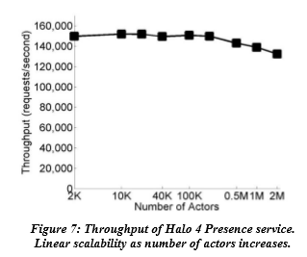
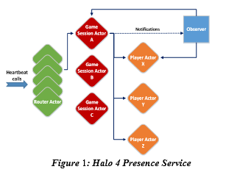
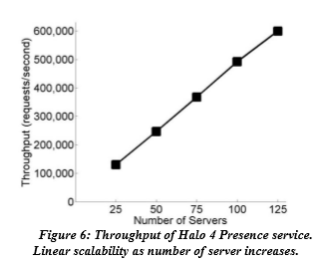
“Orleans: Distributed Virtual Actors for Programmability and Scalability”*
* https://www.microsoft.com/en-us/research/wp-content/uploads/2016/02/Orleans-MSR-TR-2014-41.pdf

Slide 38

Project “Orleans” Video

Slide 39
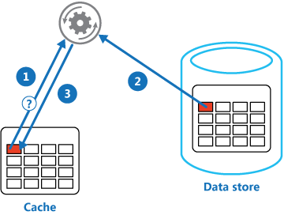
Cache-Aside Pattern
Load data on demand into a cache from a data store
Determine if item is in cache
If not load it from the store
Store item in cache
Return item
Issues and Considerations
Lifetime of cached data
Evicting data e.g. LRU
Consistency
https://aka.ms/cache-aside-pattern
Notes:
Consider the Cache-Aside pattern on READS
All very well and good at this point but how to we speed up reads from a database where the same query is requested often
Determine if the item is in the cache
If not load it from the store
Store the item in the cache
Return the item
// Distributed Caches vs In memory Caches – Network Overhead vs. Memory Consumption
// Redis Cache Service

Slide 40
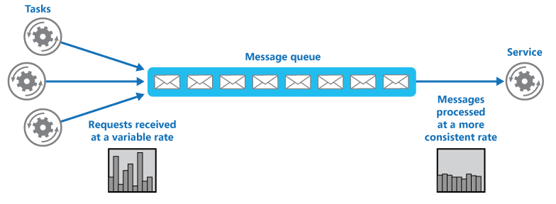
Queue Based Load Leveling Pattern
Queue that acts as a buffer between task and service
Smooth intermittent heavy loads where flooding a service could cause failure or timeouts
https://aka.ms/queue-based-load-leveling-pattern
Notes:
Push Inserts through Queue with a single consumer.
// Talk about
Asynchronous, so return a 202 – Accepted http message, not a 200 – Success message
CAN Expose a query function url separately for the result (blob endpoint)
Eventually bottleneck will be 24 hr operation of a maximum sized queue consumer.

Slide 41
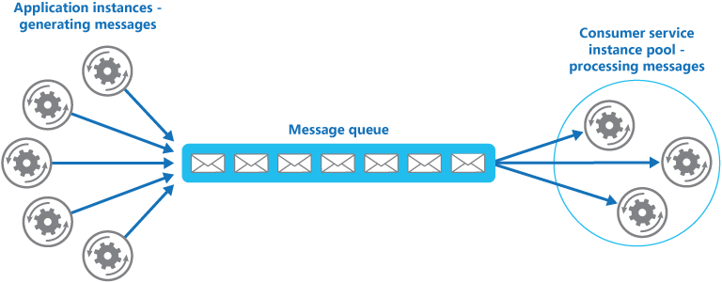
Competing Consumers Pattern
Multiple concurrent consumers process messages from same messaging channel
Optimize throughput, improve scalability
Issues and Considerations
Idempotency to handle messaging order
Detecting poison messages
Handling results back
https://aka.ms/competing-consumers-pattern
Notes:
Scaling out: when our queue consumer becomes a bottleneck, simply run more instances of the consumer.
If the receiver data layer service is a bottleneck, look to the Sharding pattern to split load across multiple dbs or storage accounts.
This is already implemented for us for free as we are using functions, if we simply choose a hosting plan with multiple cores or instances then webjobs / functions will run it flat out.
Usually the data tier is hard to scale, not with this design

Slide 42
Scalability – What to avoid?

Slide 43
Scalability – Ignore at your peril
Ignore your scalability approach
Some customers believed that the Azure platform automatically handled scaling across all Azure services, without any configuration. This is not true. This is an important concept, which customers must be aware of. For example, Web Apps require scalability rules to be configured, as do VM Scale Sets.
Ignore downtime for scale UP
A number of customers had Single Points of Failure, due to having single instances of certain resources. As such, if they wanted to scale up/out, there could potentially be some down time.
Customers should be aware of the requirements to meet Azure SLAs (particularly for VMs), and also how the platform scales services in use.
Share app service staging slots
Some customers have planned to host their separate environments on the same Web Application, but across different staging slots. All slots run on the same machine, so any strain on load would effect all environments.
Customers should ensure that the environments are appropriately separated, so that load in one environment, does not negatively impact another.
Notes:
https://azure.microsoft.com/en-gb/documentation/articles/best-practices-scalability-checklist/
https://azure.microsoft.com/en-gb/documentation/articles/best-practices-data-partitioning/
https://azure.microsoft.com/en-gb/documentation/articles/storage-concurrency/

Slide 44
https://pollev.com/ukdx
How do you scale out state in your application?
Notes:
https://www.polleverywhere.com/multiple_choice_polls/tB2ywb8sXljcKpp

Slide 45
Performance – ignore at your peril
Ignore caching / or use excessive caching
Many customers caching approach is not appropriate for their solution. This is true across various levels (e.g. Caching of data via Redis cache, through to caching of assets via CDN).
Customers should consider their SLAs (in terms of service requirements), and understand how caching can improve performance compared to adding additional complexity and cache lifecycle headaches.
lack of design for latency
Highly variable latency is normal for access to internet based services as are random timeouts and transient errors as services auto-scale and auto-recover.
When operating services in the cloud, latency constraints usually need to be relaxed and there needs to be an acceptance that some operations will timeout and need to be retried automatically.
Notes:
https://azure.microsoft.com/en-gb/documentation/articles/best-practices-scalability-checklist/
https://azure.microsoft.com/en-gb/documentation/articles/best-practices-caching/
https://azure.microsoft.com/en-gb/documentation/articles/storage-scalability-targets/

Slide 46
https://pollev.com/ukdx
Application Design - Check the following that are true
Notes:
https://www.polleverywhere.com/multiple_choice_polls/tB2ywb8sXljcKpp

